Slide 1

Improving collaborations:
Research for global oncological and surgical care
Program for equitable access in surgical care
Dr Sarah Rayne
BSc MBChB MRCS(Eng) MMed FCS(SA)
Helen Joseph Breast Care Clinic and
Program for equitable access in surgical care
Department of Surgery | University of the Witwatersrand
Johannesburg | South Africa

Slide 2
The “10/90 Gap”
Only 10% of global health research addresses 90% of global health burden
High income countries still account for 85% of publications
Fails to addresses
  Disease characteristics in LMICs
  Impractical guidelines
  Misleading outcomes
Rottingen JA, Regmi S, Eide M, Young AJ, Viergever RF, Ardal C, et al. Mapping of available health research and development data: what's there, what's missing, and what role is there for a global observatory? Lancet 2013 Oct 12;382(9900):1286-1307.
Moran M, Guzman J, Ropars AL, McDonald A, Jameson N, Omune B, et al. Neglected disease research and development: how much are we really spending? PLoS Med 2009 Feb 3;6(2):e30.

Slide 3
The “10/90 Gap”
Absence of local research for local needs
  HIV in surgical outcomes
  TB as a surgical disease
  Late stage cancer management strategies
  Low resources solutions & guidelines
1% biomedical research publications from SSA
North-South collaborations
  Capacity building
  Unmatched agendas
Rahman M, Fukui T (2003) Biomedical publication–global profile and trend. Public Health 117: 274–280. doi: 10.1016/s0033-3506(03)00068-4
Binka F (2005) Editorial: north-south research collaborations: a move towards a true partnership? Trop Med Int Health 10: 207–209. doi: 10.1111/j.1365-3156.2004.01373.x

Slide 4
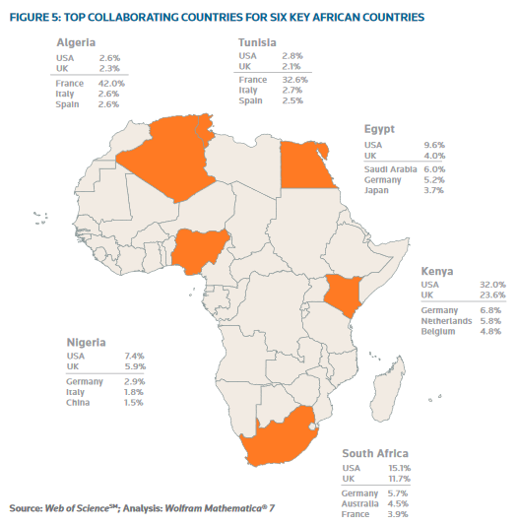
Inter-continental
http://sciencewatch.com/sites/sw/files/sw-article/media/globalresearchreport-africa.pdf

Slide 5
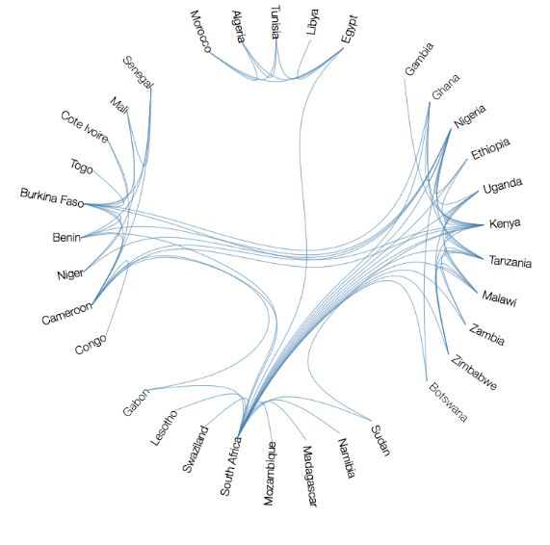
More than 5 publications
More than 5 years
Intra-continental
International collaboration clusters in Africa Jonathan Adams(1) Karen Gurney(1) Daniel Hook(2) and Loet Leydesdorff(3

Slide 6
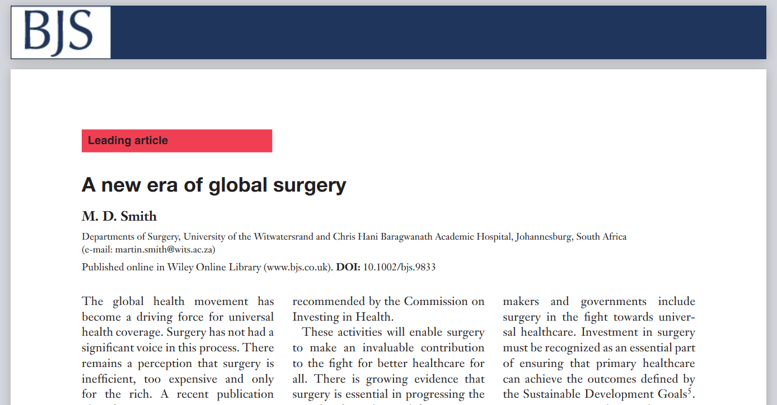
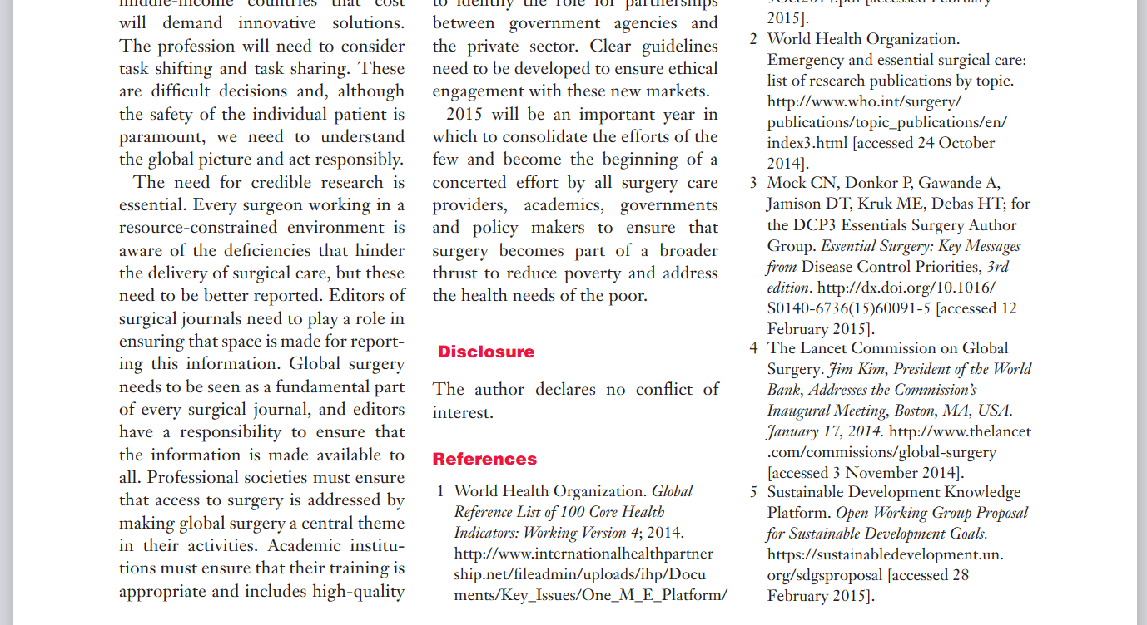

Slide 8
ABCD

Slide 9
ABCD
Always be collecting data

Slide 10
Possible barriers to clinical research
Service commitment
Academic barriers
Inertia in application

Slide 11
Possible barriers to clinical research
Service commitment
Academic barriers
Lack of supervision
Time constraints
“Hurdle” mentality
Insular working practices
Lack of research training and support
Ring-fenced time for research work
Internet access
Poor record-keeping
Good quality data
Relevance of questions
Audits
Inertia in application

Slide 12
Possible barriers to clinical research
Service commitment
Academic barriers
Lack of supervision
Time constraints
“Hurdle” mentality
Insular working practices
Lack of research training and support
Ring-fenced time for research work
Internet access
Poor record-keeping
Good quality data
Relevance of questions
Audits
Inertia in application

Slide 13
Future of healthcare quality is in data.
Data that is timely and of quality.
Slide from Dr Ewen Harrison

Slide 14
Possible barriers to clinical research
Service commitment
Academic barriers
Lack of supervision
Time constraints
“Hurdle” mentality
Insular working practices
Lack of research training and support
Ring-fenced time for research work
Internet access
Poor record-keeping
Good quality data
Relevance of questions
Audits
Inertia in application

Slide 15
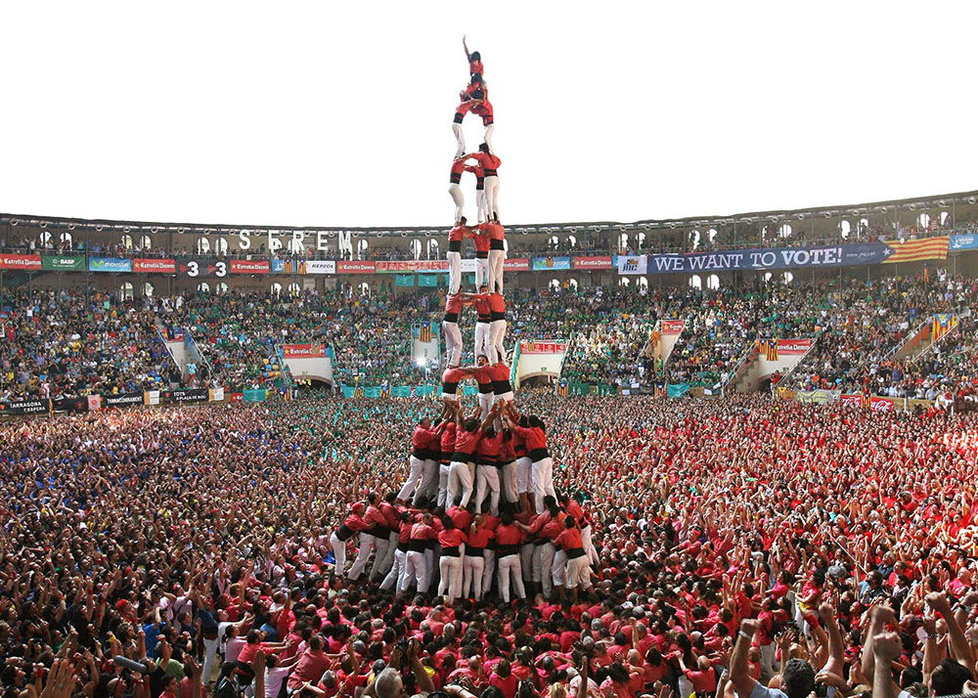

To improve surgical care through observational and interventional research
Slide from Dr Ewen Harrison

Slide 16
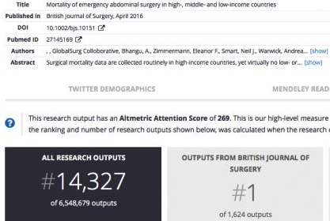
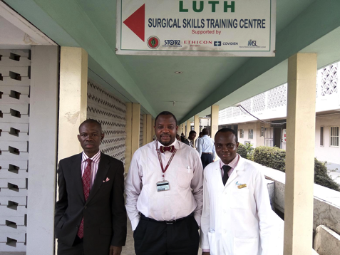
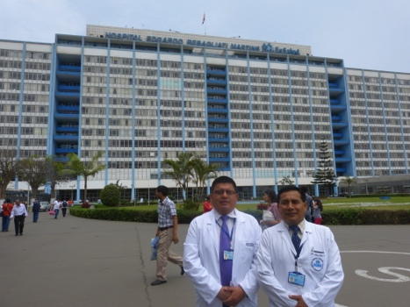
66 countries, 353 centres, 25000 patients
First paper highest Altmetric score from BJS – EVER
Outcomes: Death, SSI, morbidity

Slide 17
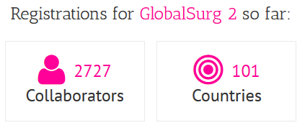
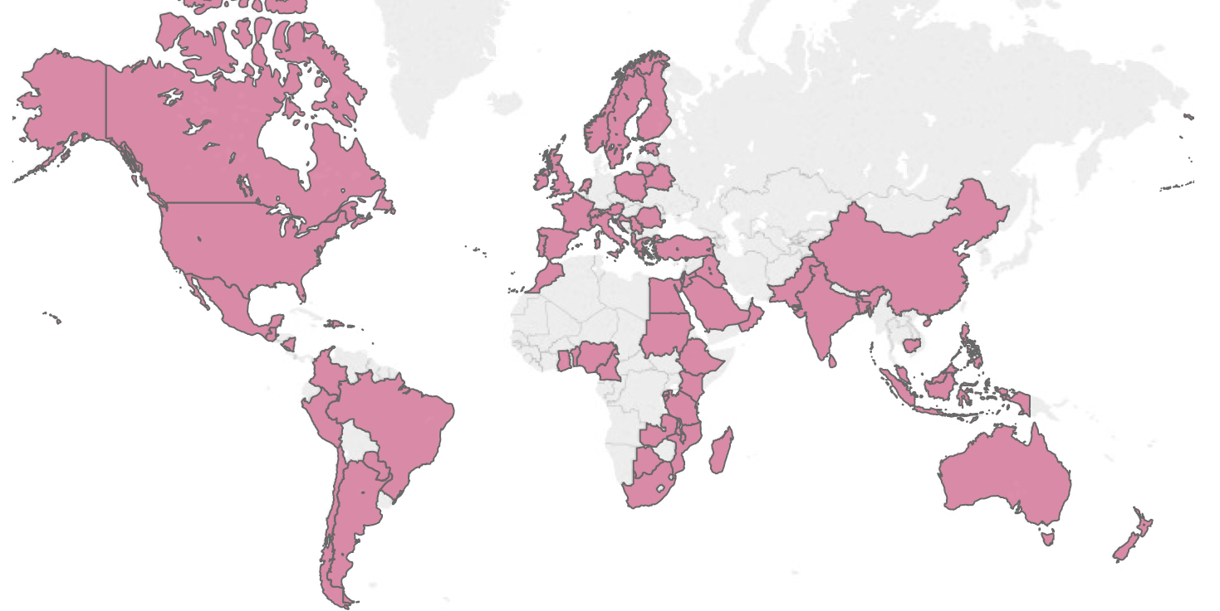
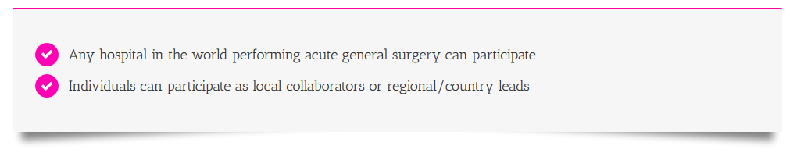
Slide from Dr Ewen Harrison

Slide 18
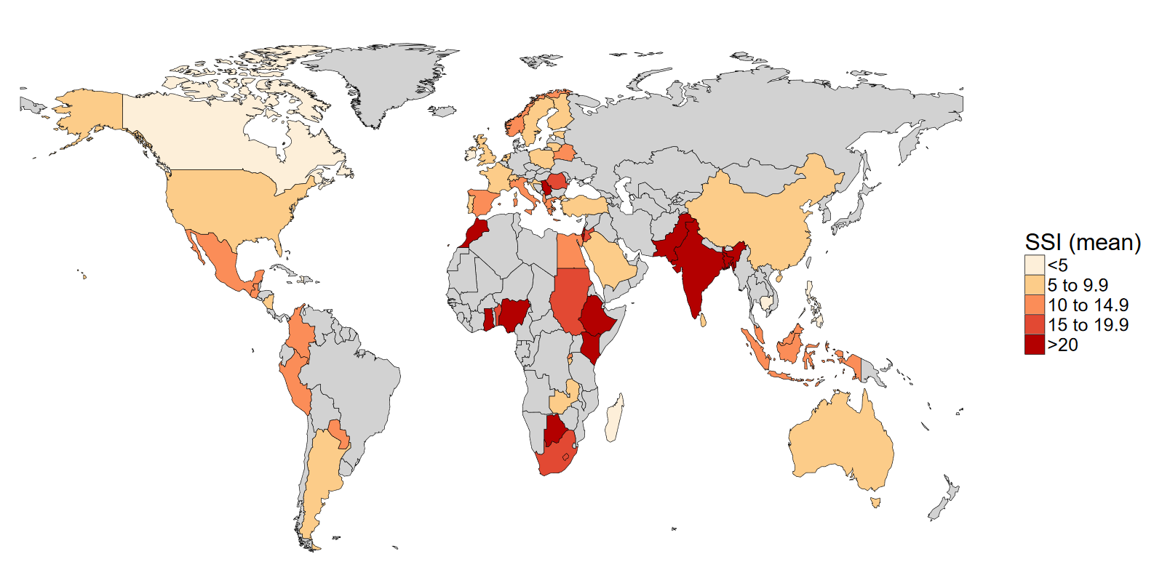
SSI rate (%)

Slide 19
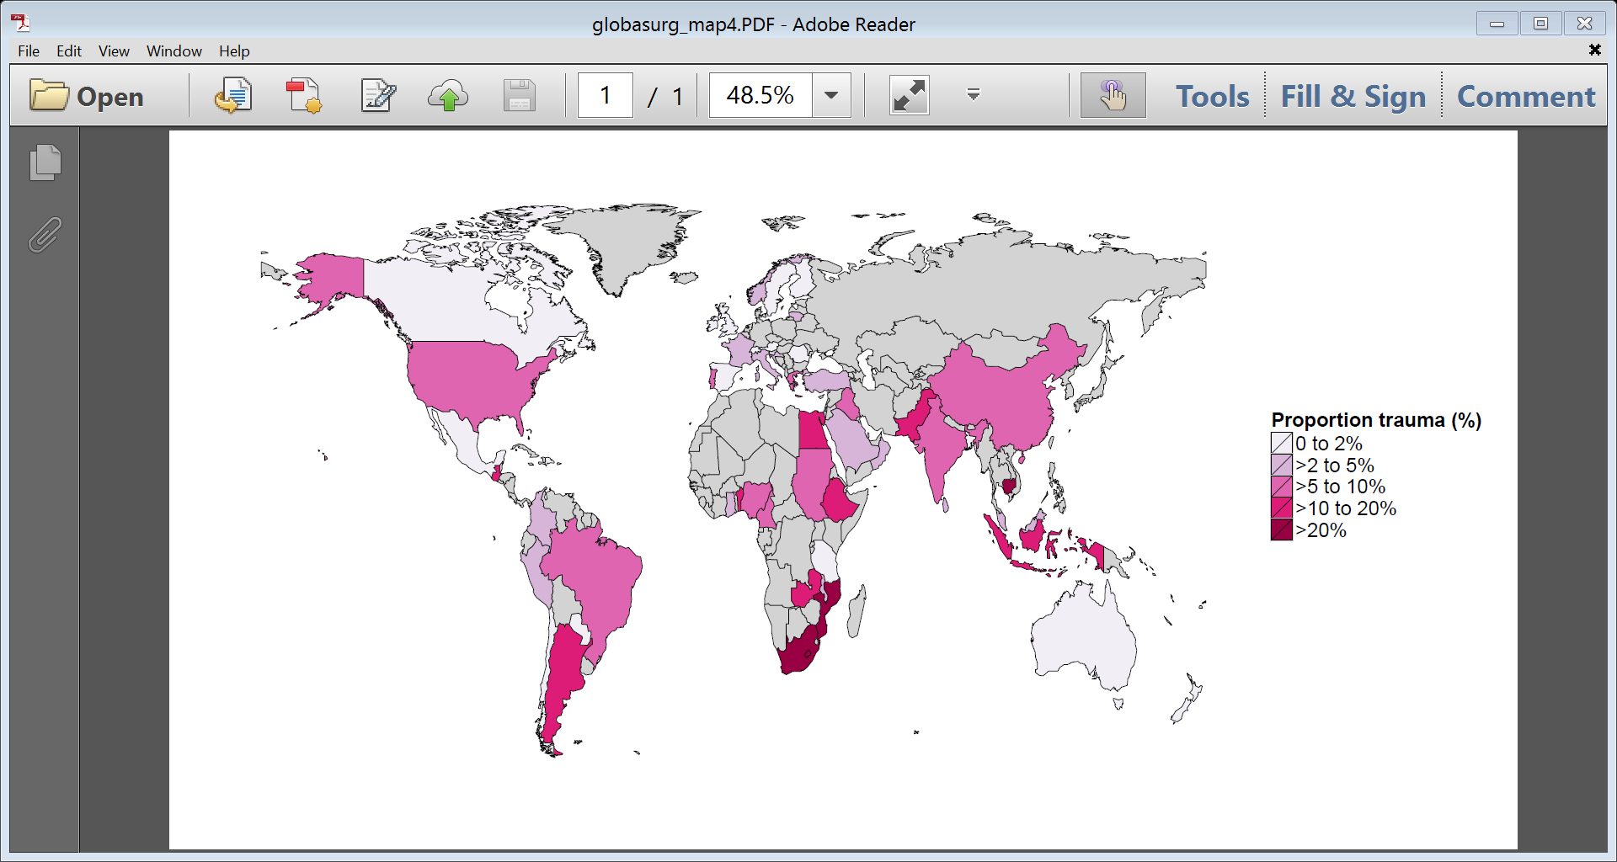
Penetrating Trauma SA vs Global OR 24.6 (P <0.001)

Slide 20
Research
Patient care

Slide 21
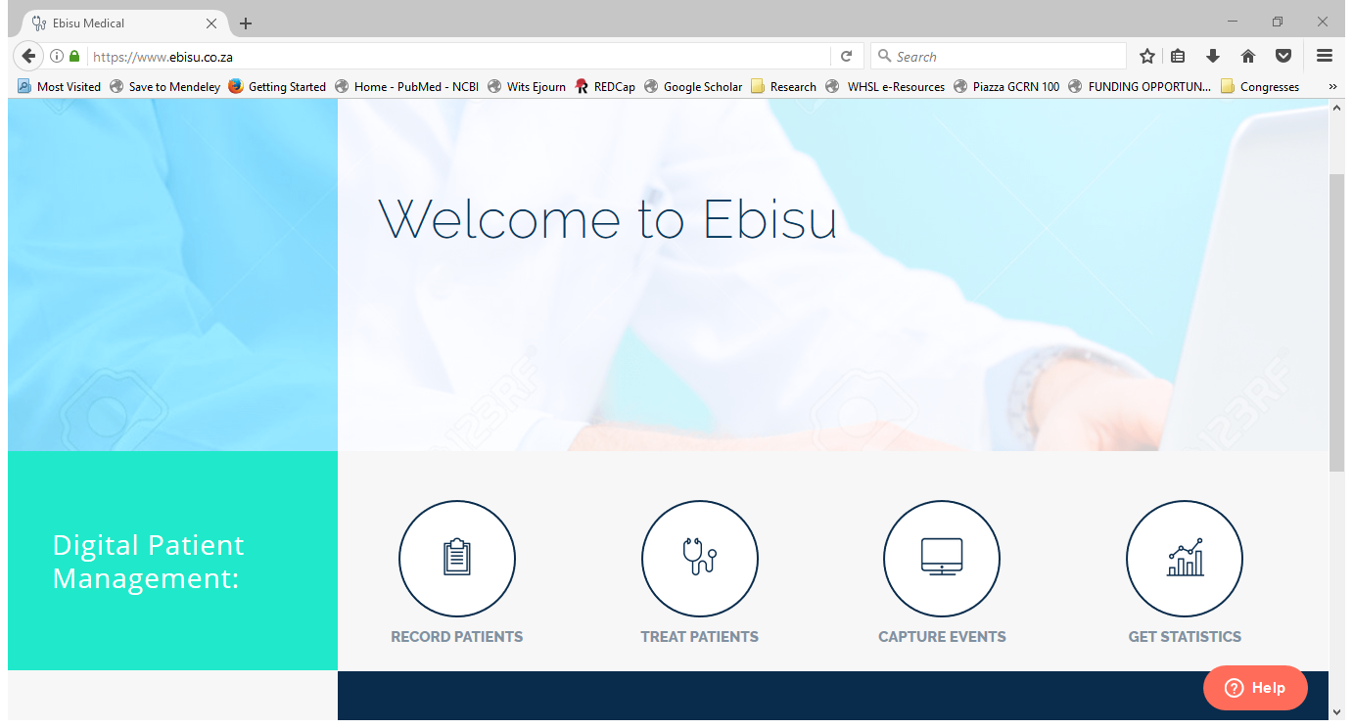

Slide 22
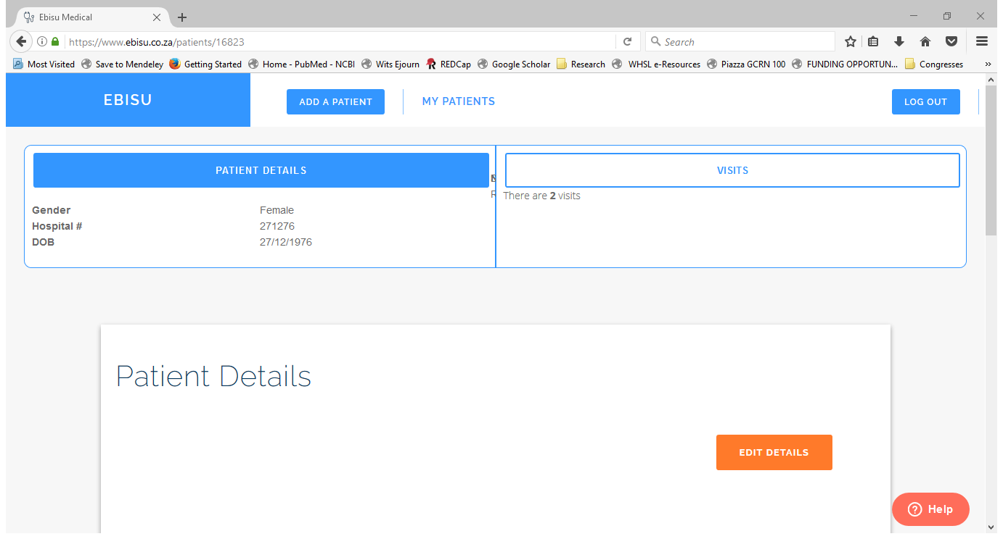

Slide 23
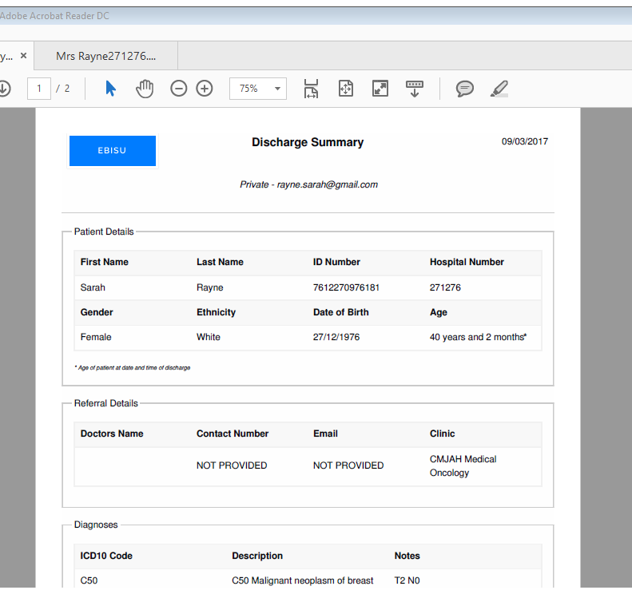

Slide 24
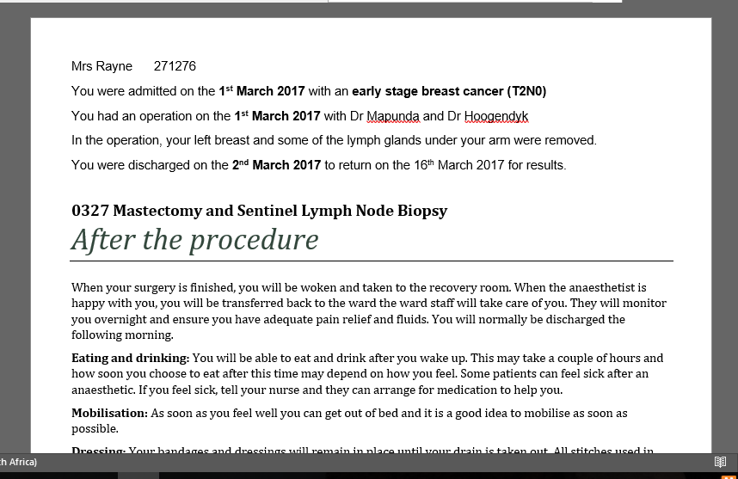

Slide 25
Local-National-Global picture
Global CRF and administration
National/ Regional ethics organisation and support

Slide 26
Local-National-Global picture
Global CRF and administration
National/ Regional ethics organisation and support
Local hospital approval and data collection

Slide 27
Local-National-Global picture
Global picture
Hypothesis generating
Building and supporting capacity
Global CRF and administration
National figures
Collaborator experience
Hospital audit
Investigator experience
National/ Regional ethics organisation and support
Local hospital approval and data collection

Slide 28
Local-National-Global picture
Global picture
Hypothesis generating
Building and supporting capacity
Global CRF and administration
National figures
Collaborator experience
Hospital audit
Investigator experience
National/ Regional ethics organisation and support
Local hospital approval and data collection
Flattened hierarchy
Ideas and analysis in both directions
Investigators move up the chain with experience and capacity

Slide 29
Summary: building capacity for multi-centre audits and studies
Global collaborations provide local data and bench-marking
  Centralised steering committee and admin increases feasibility
    Study design, set-up, database
    Reduces time and organisational burden
    Increases research capacity (GCP; CRF design; stats)
  Web-based technology increases the capacity for local audits and surgical outcomes research
  Stimulating responsible and mandatory culture of audit and accountability without barriers
Building of contacts
  Inter-departmental; inter-regional; international; inter-discipline
  Dissemination of knowledge about projects
  Flattened hierarchy- student/trainee/consultant
Central Meritocratic authorship

Slide 30
Program for equitable access in surgical care
peasc.org
globalsurg.org
+27 72 776 8553
rayne.sarah@gmail.com
@DrSarahRayne
?
Any questions

