Slide 1
Training and research enhancement
Yohana Mashalla
Lucy Mokgatlhe
University of Botswana
Launching of Peo Project: 09th March 2017

Slide 2
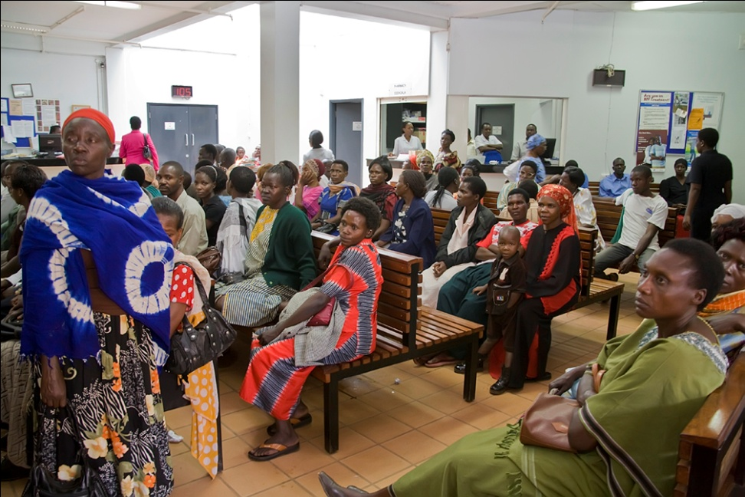
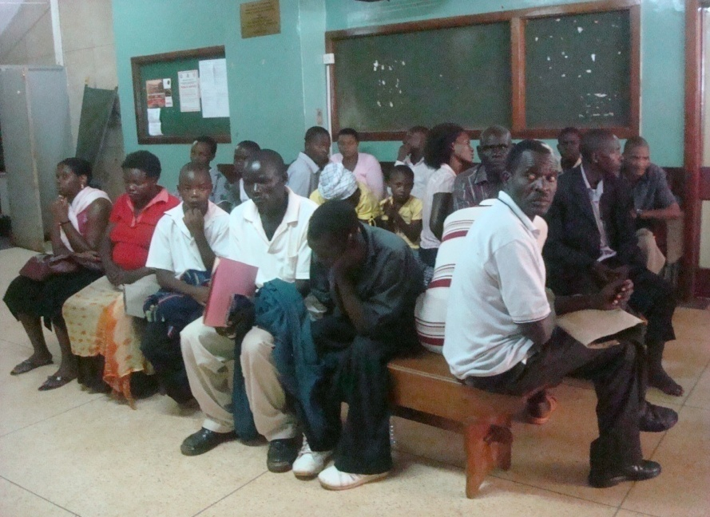
Training Goal
To contribute to building NCD research capacity in Botswana using trauma as the flagship NCD targeting health, paramedics and social scientists

Slide 3
Specific objectives
Provide trainees with in-depth knowledge of the research techniques appropriate for epidemiologic research as applied to research questions in NCDs and associated diseases outcomes;
Provide intensive, supervised research experiences with mentors in epidemiology to trainees; and
Unite faculty and trainees at BHP, UB, Botswana-UPenn Partnership, and Ministry of Health through seminars and workshops.

Slide 4
Features of the training programme
Sub-Saharan Africa – centric
Trainees and trainers will come from sub-Saharan Africa
Multidisciplinary
Doctors, nurses, paramedics and social scientists will be trained together
South-south collaboration
Draws experiences from Botswana and South Africa
Targeting sustainable African training capacity
Catalyst for institutional development in research, clinical and public health practice, and policy development.
Flexible platform for scale-up
Expanding the program by including other interested academic institutions in Africa

Slide 5
Training and research enhancement
The Training and Research Enhancement core seeks to specifically address Aim 3 to Aim 5 of the P20 Proposal:
Aim 3: To conduct targeted research projects in breast cancer (in Botswana and South Africa) and hypertension (in Botswana).

Slide 6
Training and research enhancement
Aim 4: To establish a road-accident trauma registry in Botswana, as an initial step in assessing burden of disease and informing development of a national trauma system.
Aim 5: To expand the cadre of local skilled NCD researchers in Botswana and South Africa through research enhancement activities.

Slide 7
Training overview
This training has three major components or phases:
Core Curriculum Didactic Block
Taught at UB for three weeks through direct participation and problem-solving learning methods.
Mentorship
Trainees will work with mentors at their workplace and draw experiences from local and international co-mentor
Post-training
Designed to provide virtual and in-person opportunities to continue to interact and collaborate with faculty, mentors, and fellow graduates.

Slide 8
Core Curriculum Didactic Block
Seeks to support the three flagship research focus areas of Trauma, breast cancer and hypertension through the provision of adequate support that encompasses
Assessing the statistical and design needs of the proposed research,

Slide 9
Core Curriculum Didactic Block
ii) Establishing requisite analytical skills and providing the necessary tools through training,
iii) Responsible for faculty versus masters training of research staff within the core, and any charge-back mechanism that may be required to support core efforts.

Slide 10
Core Curriculum Didactic Block
Coverage in the following bio-statistical areas of needs are envisaged
Health Research Study Designs: (case-control studies, cross-sectional studies, cohort studies, Randomized studies, etc.)
Handling continuous and categorical response data
Sample size and power computation for different design studies

Slide 11
Core Curriculum Didactic Block
4. Assessing confounding by indication
Measures of association
Use of statistical packages to handle and analyse data ( R, SPSS, STAta )

Slide 12
Structure
Didactic Modules
Mentorship
Review of progress
Mentorship & implementation
3 Week-long modules
6 Month mentorship and proposal writing
2 days report back on progress
Sustained life long mentorship and implementation
Introduction
The mentorship will take place at the mentees institution where mentors will be identified. Focus will be on application of biostatistics and grant writing.

Slide 13
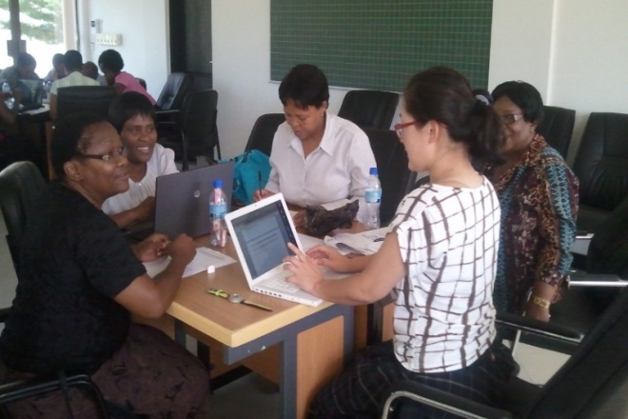
Didactic modules
Focus: Skills building of professionals who will become Independent Investigators in Botswana in NCDs
Group work: Promotes South-South interactions
Specific topics:
Fundamentals of Biostatistics in Practice
Introduction to Epidemiological Research Methods
Data Analysis using R software:
Clinical Trials and Research Ethics
Applied Survival Analysis

Slide 14
Didactic modules
These are non-degree courses, thus no certificate shall be awarded for completion
Each course module will be completed in total of 36 hours.
These compares well with any University of Botswana 3 credits graduate course.

Slide 15
Eligibility
Employed at a collaborating Peo project institution, or at an affiliate institution
Health-related fields including medicine, public health fields, social sciences, biomedical sciences, and have a Masters degree level training or higher in the relevant field. Examples include:
MD, MBBS or MBChB with a MMEd or Master degree in a related field
Master degree in nursing, public health or other health related professional field
Working in research projects e.g. U54, D43. Afya Bora is added advantage

Slide 16
Recruiting procedures
Aspiring candidates in Botswana should submit applications to the address at Botswana-Harvard AIDS Institute Partnership
Deadline: 16th march 2017
Shortlisted candidates MUST appear before a Panel for interview on 27th March 2017
Candidates failing to appear for interview will be disqualified.

Slide 17
Expected outcomes
Intense practical training in research training methods for NCD`s, (cancer, trauma, CV diseases) developed in Botswana and South Africa
Trained Independent Investigators in NCDs research in Botswana and South Africa
Expanded research capacity by forming teams to carry out specific projects in the region

Slide 18
sustainability
Existing synergies (UB54, D43, BHP, BUP, Afya Bora, academic curricula at UB)
Trained graduates will sustain research activities, write proposals, establish networks nationally, regionally and internationally
Facilities will form sustainable technical support
Academic sustainability through integration of the training curriculum in training institutions

Slide 19
Course contents
All the five courses are applied biostatistics courses

Slide 20
Fundamentals of Biostatistics in Practice
This course will be a series of lectures that covers topics in: types of variables, descriptive statistics: mean, standard deviation, standard error, skewness; median, percentiles; parameter and statistics, Sampling distributions for mean and proportion, standard errors, Confidence Intervals, Parametric and non-parametric hypothesis testing and evaluating p-value, ANOVA, chi-square goodness of fit and contingency tables.

Slide 21
Introduction to Epidemiological Research Methods
This course will cover topics on:
definition of epidemiology, evaluation of diagnostic tests,
review of study designs like cross-sectional, case-control, cohort studies, randomized clinical trials,
analysis of data from epidemiological studies using measures of disease frequency, prevalence and incidence rates; measures of association: relative risk, attributable risk, odds ratio, McNemar test

Slide 22
Data Analysis using R software
Introduction to R, data management in R, data entry, importing files, graphics using ggplot2, window driven analysis (Rcmdr), simple linear regression using R, non-linear regression (logistic, probit, ordinal multinomial, poisson).

Slide 23
Clinical Trials and Research Ethics
The course will cover topics in
types of intervention studies, different stages of clinical trials,
principles of clinical trials: randomization, replication and stratification, design and analysis of cross-over trials.
Different stages in clinical trials, Superior, non-inferior and equivalence clinical trials,
Sample size and power determination.
Patient consent, research ethics in clinical trials, Interim analysis of clinical trial data, data safety monitoring,

Slide 24
Applied Survival Analysis
This course focuses on analysis of time to event data and shall cover topics like:
Types of censoring,
Estimation of survival functions,
semi-parametric tests, proportional hazards, comparison of groups,
sample size and power determination.

Slide 25
Thank you

