Slide 1
Peo Pilot Project: Hypertension
Mosepele Mosepele, MD, MSc
Co-I, University of Botswana, Botswana-Harvard AIDS Partnership
Notes:
Acknowledgement slide

Slide 2
Outline- Peo Hypertension Pilot project
Background
Aims
Setting
Progress to date
Future directions
Summary

Slide 3
Pilot research: Hypertension, background
Background:
Hypertension confers high population attributable risk of MI and CVA (INTER-HEART and INTER-STROKE); distribution of additional reversible risk factors unknown for the southern African region
Hypertension control rates are quite poor in Africa, with the best being 45% in a 2013 review article (Kayima 2013, BMC CVD)
Treated HIV disease has been associated with hypertension (and excess risk for CVD)
Participating institutions/investigators:
Dr. Mosepele Mosepele MD, MS at University of Botswana and BHP
Dr Tiny Masupe, MD, University of Botswana
Dr. Ralph D’Agostino, biostatistician/epidemiologist at BU and co-PI on Framingham Heart Study for over 30 years
Dr. Shahin Lockman, MD, MS at BWH/Boston and BHP
Notes:
Dr. Shahin Lockman is an adult internist (ID-trained) who has conducted epidemiologic and clinical trials investigations
related to HIV and tuberculosis in southern Africa since 1996, focusing on biomedical approaches to
preventing mother to child transmission (MTCT) of HIV-1; treating women (and infants) with antiretroviral drugs
following exposure to antiretroviral for MTCT prevention; optimizing the health of HIV-infected mothers and
HIV-exposed and -infected children; and studying the best approaches to feeding the HIV-exposed infant in
resource limited settings. She has also participated in (and mentored investigators related to) implementation
science studies focused on safe infant male circumcision; adult cancer spectrum and outcomes; and risk
factors for cardiovascular disease. For the proposed project she will assist with design of research and training
plans, and participate in project conduct and assessment of progress. She will also assist with developing new
research projects; will help identify and contact new regional collaborators; and will advise on regulatory issues
and engagement of community/local stakeholders as part of this project.
Dr Ralph D’Agostino is a Professor of Mathematics/Statistics, Biostatistics and Epidemiology at Boston
University and the Executive Director of Biostatistics and Data Management at Harvard Clinical Research
Institute. He has been a co-Principal Investigator on the Framingham Heart Study for over 30 years and
received special recognition in 2014 from the American Public Health Association for being in the top 1% of
cited authors in Clinical Medicine. Professor D’Agostino is committed to mentoring Dr. Mosepele and his team
of hypertension researchers on study design, approaches to statistical analyses based on available data, and
preparation of scholarly works. Professor D’Agostino will provide technical support in the preparation of
Biostatistics and Epidemiology curriculum for the NCD training component of the grant. He does not require
salary support through this grant to carry out his mentoring and technical role.

Slide 4
Pilot research: Hypertension, pilot project
In a population-based sample of adults in Botswana, to assess:
Prevalence of hypertension (either previously diagnosed, or current SBP>140 or DBP>90)
Proportion of adults previously/currently prescribed antihypertensives
Blood pressure/hypertension among patients currently prescribed treatment
Predictors of hypertension
Self-report of prior counseling on basic CVD risk factors among those with prior htn diagnosis (smoking cessation, moderation of salt/alcohol intake, exercise, lipids, DM scr.)
Hypertension prevalence by HIV status
Hypertension control by level of care in the health system
Hypertension pilot project will be conducted in unique population-based cohort of randomly-sampled, well-characterized adults age 16-64 years in 30 communities from Botswana (Botswana Combination Prevention Project, BCPP)
Hypertension pilot will be conducted in subset of 3,000 participants
Assessments will include interview/survey, bilateral UE BP x 2; waist and hip circ x 2
Notes:
Comparison of the % of HIV+ vs. HIV- individuals with hypertension who are on treatment is one of the few formal comparisons proposed. We hypothesize that 65% of HIV+ persons with hypertension are treated for hypertension, vs. 50% of HIV- persons being treated, we would need to assess at least 366 HIV-negative and 122 HIV-infected participants to observe a difference, with 80% power (and alpha 0.05).
With 3000 participants in the hypertension assessment, if we assume that 20% will have hypertension (already diagnosed/treated and/or current):
~600+ will have hypertension (diagnosed or current); ~450 will be HIV-uninfected and ~150+ of these individuals will be HIV-infected.

Slide 5
Hypertension Pilot Project: BCPP Study Design Overview
Pair-matched community-randomized trial in 30 communities, assessing impact of combination prevention interventions on 30 month cumulative HIV incidence
15 combination prevention intervention and 15 standard of care
Baseline and annual surveys conducted in all consenting adults residents in a randomly-selected sample of ~20% of households in all 30 communities, to assess HIV incidence
Baseline and annual HIV testing
Extensive data on sociodemographic factors, health, sexual risk behavior, major health outcomes QOL/RU are collected at baseline and annually on two subsequent surveys
13,000 adults already enrolled and being followed; will enroll additional 9,000 participants in 6 communities during final round
Starting the final round of annual surveys (in March 2017)
Unique opportunity to characterize population-based random sample of adults from across Botswana by leveraging large, very costly infrastructure
Notes:
Mochudi Project - Gates
8 October 2008
5

Slide 6
Botswana Combination Prevention Project:
15 standard of care
communities
(n~90,000)
End of study survey
(100% of 3 pairs)
20% cohort
20% cohort
20% cohort
Randomize
Baseline
Month 12 follow-up
Month 30 follow-up
20% cohort
20% cohort
15 intervention
care communities
(n~90,000)
20% cohort
Interventions
Household/mobile HIV testing
Linkage to care
Expanded/Universal ART
Rapid ART
Expanded Male Circumcision

Slide 7
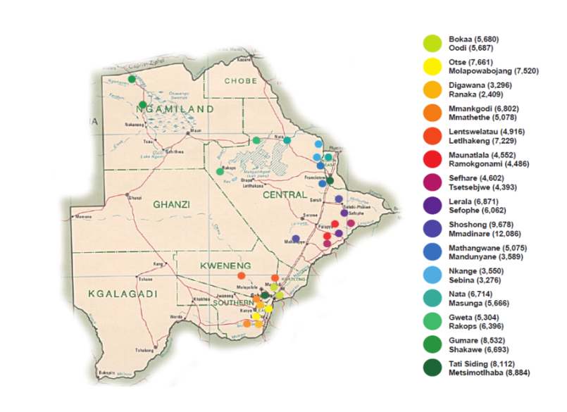
BCPP Study Population
Average community population 6,000
Total population ~180,800 (nearly 10% of entire Botswana population)
Age-eligible (16-64) ~105,000

Slide 8
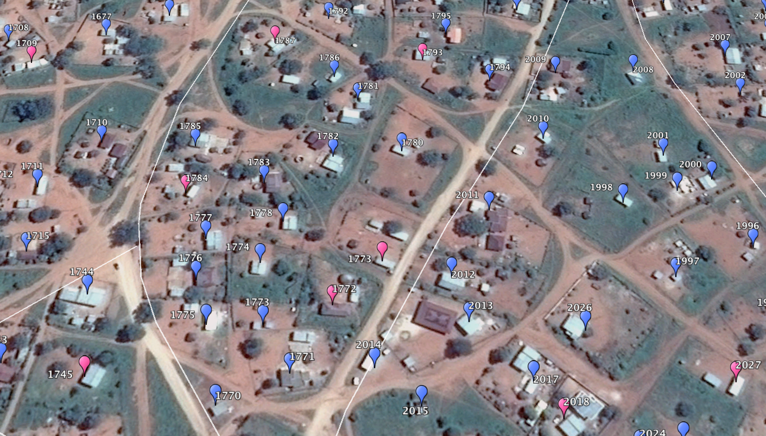
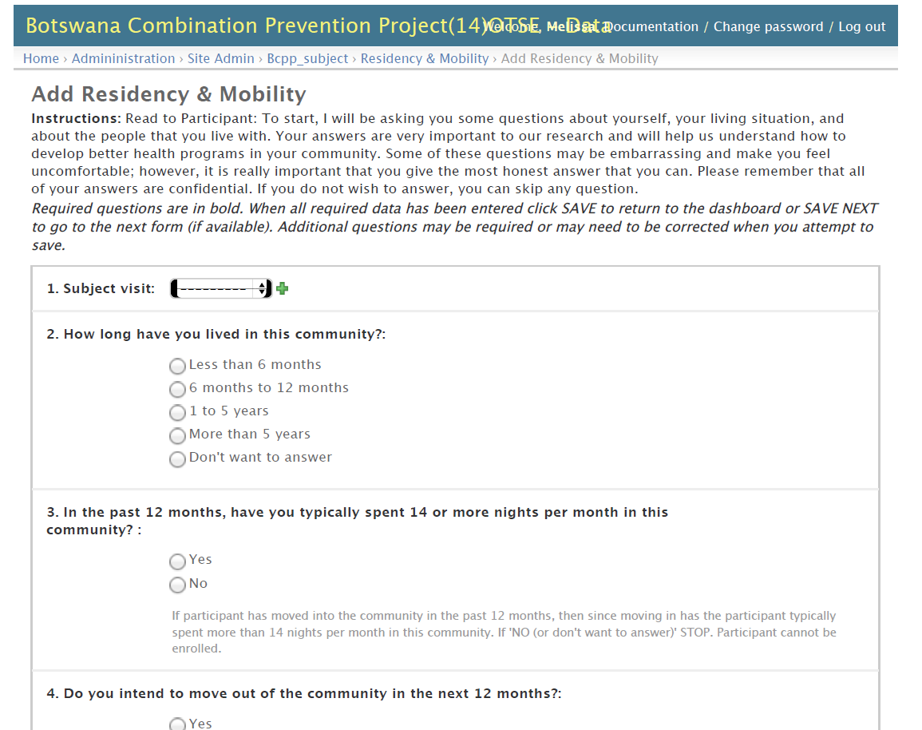
BCPP Plot Mapping and Electronic Data Capture
Screen shot of an electronic data capture survey
GPS coordinates to map and confirm plot
Household data linked to plot (and individual data to household and plot)
73,700 plots mapped in 30 communities
20% selected for household survey
Maps also used by HTC campaigns

Slide 9
Hypertension Pilot Project: Progress
Data collection instruments developed
Materials submitted to IRBs (approved by CDC/BCPP sponsor IRB, anticipate approval by Botswana IRB this week)
After IRB approval, anticipate initiation of data collection in March 2017 (through February 2018)
Study RA`s have completed training on administration of the questionnaire, and completing study measurements

Slide 10
Future directions
Hypertension
Prevalence of unmanaged reversible cardio-metabolic risk factors; may inform task shifting training curriculum and approach to decentralization of services to primary care level.
New approaches to engaging people in preventive care
Explore healthcare system factors in blood pressure control
Role of environmental factors in blood pressure control

Slide 11
Summary
Hypertension:
Assess prevalence of hypertension (treated and untreated) and prior risk factor screening in a population-based cohort of 3,000 well-characterized adults from throughout Botswana (and evaluate control plus predictors, including HIV)

