Slide 1







Breast cancer pilot:
Evaluation of breast cancer care and outcomes in the setting of Breast multidisciplinary clinic in Botswana
Notes:
Acknowledgement slide

Slide 2
Outline
Overview of breast research project
How project fits into research environment and shared resources
Progress to date

Slide 3
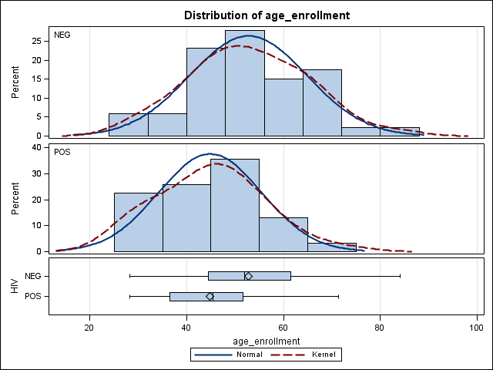
Background
Breast cancer survival rates are significantly lower in LMIC
  Five years OS: 86% in Canada, 88% in the US, 64% in South Africa, and 56% in Uganda, and significantly less than this in many parts of Africa (Gakwaya et al)
  Late diagnosis (Brown C et al, Unger-Saldaña et al)
  Sub-optimal treatment
30-35% of women with breast cancer in Botswana and at Wits are HIV-infected, and significantly younger (median age 33 years) compared with HIV-uninfected (median age 55 years)
Age distribution of breast cancer cases in BPCC (Botswana) by HIV status. (p<0.01)

Slide 4
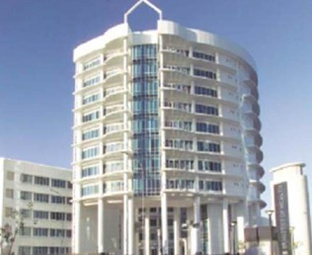
Context: Botswana
National cancer registry:
  ~330 new breast cancer diagnoses annually
Botswana Prospective Cancer Cohort:
  Observational prospective cohort enrolling since 2010 (n>2,000, ~90% of patients presenting for cancer care in Botswana)
  Collects extensive sociodemographic, clinical, treatment type, and clinical outcomes data on all consenting patients presenting for cancer care in Botswana
National referral hospitals:
  Deliver specialty cancer services
  Multidisciplinary breast clinic at PMH since October, 2015 (for patients with suspected and confirmed breast cancer), but not yet available at NRH

Slide 5
Context: South Africa
Helen Joseph Breast Care Centre at Wits
Public hospital in Johannesburg, serving catchment of ~1 million
~350 new breast cancer diagnoses annually
Already has an established multidisciplinary breast cancer care clinic

Slide 6
Project team/investigators
Bruce Chabner: Chief of Division of Hematology/Oncology at MGH (Harvard) and CMO for Dana Farber/Harvard Cancer Center at Harvard. Extensive experience in clinical cancer research
Lawrence Shulman: Director of Global Cancer Medicine at Abramson Cancer Center at the UPenn, breast oncologist, experience with oncology program development in LMICs
Sarah Rayne: full-time surgeon, co-manages breast service at University of the Witwatersrand. Research focuses on psycho-social barriers to accessing breast cancer care
Neo Tapela: head of NCD program MOHw, research associate BHP, research focuses on reducing delays in diagnosis of cancer and decentralizing integrated NCD services
Sebathu Chiyapo, Dipho Setlhako, Mohan, Scott Dryden-Peterson, Surbhi Grover, Elizabeth Bigger, Teddy Monnatlhare, Mukendi Kayembe, Moneimang Makgasa, Isaac Nkele, Kerapetse Botebele
Notes:
Bruce Chabner, M.D., the co-Principal Investigator (0.24 Calendar Months), is a Professor of
Medicine, Harvard Medical School, Clinical Cancer Center Director and Chief, Division of
Hematology/Oncology, Massachusetts General Hospital, and the Chief Medical Officer for
DF/HCC. Dr. Chabner has participated in all phases of cancer drug discovery, development,
clinical testing, and in biochemical and molecular studies of drug action over the past 30 years.
As the Director of the Division of Cancer Treatment of the National Cancer Institute from
1982-1995, he oversaw the development of clinical evaluation of a number of NCI compounds,
including fludarabine, paclitaxel, and AIDS antivirals. As Clinical Director of the MGH Cancer
Center, he developed a broad program of translational research on targeted drug testing and drug
resistance. In recent years, as Clinical Director, Emeritus, and the Allen Distinguished
Investigator at MGH, he has expanded his interests to disparities in cancer care affecting
under-served communities in Boston as well as in subs-Saharan Africa. He now holds foundation
and NCI grants supporting studies of interventions to address disparities in both the Boston
community and in Africa (Botswana).
At the DF/HCC Dr. Chabner chairs the Initiative to End Cancer Disparities (IECD). With the
assistance of Karen Burns White, the IECD has organized monthly meetings to promoted
interaction among the investigators responsible for more than 70 ongoing research projects at
DF/HCC which address racial and ethnic disparities in cancer diagnosis, treatment, and
prevention. In the proposed research agenda in Botswana, he will direct the development of
initiatives to improve breast cancer care through the development

Slide 7
Primary Aim
To assess the impact of multidisciplinary breast cancer care clinics in quality of care
  Decreasing time to treatment initiation (primary)
  Improved compliance with treatment protocols (secondary)
  2 year survival (secondary)
Will compare these endpoints between Botswana and Helen Joseph Breast Care Centre at Wits
Will also describe characteristics of breast cancer patients in Botswana, including key risk factors and pathology
Notes:
In addition to answering study questions, will allow us to establish merging of data from IPMS, RedCap

Slide 8
Methods
Establish a multidisciplinary breast cancer care clinic in Francistown Botswana, with guidance from Dr. Rayne at partners institution in South Africa (Wits)
Collect additional data at PMH and NRH (including available in IPMS), and use extensive data collected in Botswana Prospective Cancer Cohort from time periods pre- and post- implementation of multidisciplinary clinic
Eligible: adult breast cancer patients evaluated at multidisciplinary breast clinic at Princess Marina Hospital or Nyangabgwe Referral Hospital
Sample size: 160 new multidisciplinary patients (+160 historical controls)
Notes:
128 new multidisplinary clinic patients enrolled to have a power of 90% and type I error rate of 0.05 to determine if there is a 25% reduction in time of initial clinic visit to treatment initiation
Assuming that 25% of eligible patients may be lost to follow-up, we have adjusted the sample size to 160 new multidisplinary clinic patients (+ 160 historical controls)

Slide 9
Endpoints
Primary endpoint:
  Time from first clinic visit for breast complaint to treatment initiation
Secondary endpoints:
  Time from diagnosis to completion of curative-intent treatment
  Proportion of patients who receive adjuvant chemotherapy within 90 days of surgery
  Proportion of stage III patients who receive neodajuvant chemotherapy
  Proportion of hormone receptor (ER/PR) positive patients who receive tamoxifen or aromatase inhibitor within 12 months of diagnosis
  Proportion of patients who receive adjuvant radiation within 12 months of surgery or 12 months of diagnosis
  Proportion of patients who complete curative-intent treatment
  Overall 1-year and 2-year survival
Notes:
Characterize long-term adherence to tamoxifen among treated breast cancer patients at Helen Joseph Breast Care Centre
Use existing (and new) electronic tamoxifen refill data (open-source CASIS) to describe adherence to tamoxifen, and determine whether consistent with local treatment protocols

Slide 10
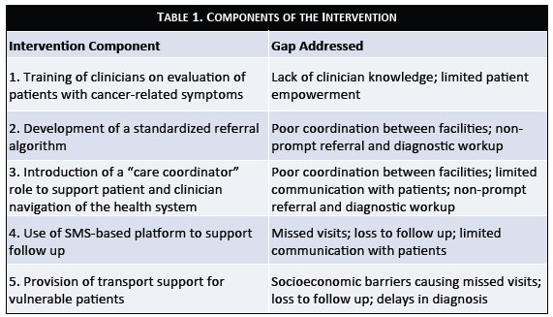

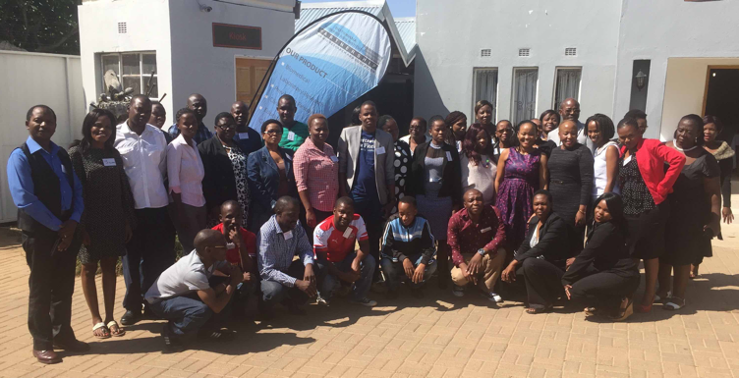
Related studies: Potlako

Slide 11
Progress to date
Core data elements drafted
Multidisciplinary clinic research protocol submitted and approved by HRDC
Submissions to partner institutions are underway
Next steps (today): detail timeline for RA, data collection, trainee mentee

Slide 12
Thank you!!

